Slide 1
Auto transcription from video files
There are multiple templates for you to pick from, each featuring a selection of imagery based on different themes
There are a variety of content slides you can use. Use the drop down arrow on the New Slide tab to make your selection
Fonts and styles are set up and embedded, so will work when sending your presentation off site
Please use square bullet points when creating lists
Use the embedded Guides to align any images/tables that you need to insert. Go to the view tab and select ‘Guides’ to enable.
Report any issues to marketing@nationalarchives.gov.uk

Slide 2
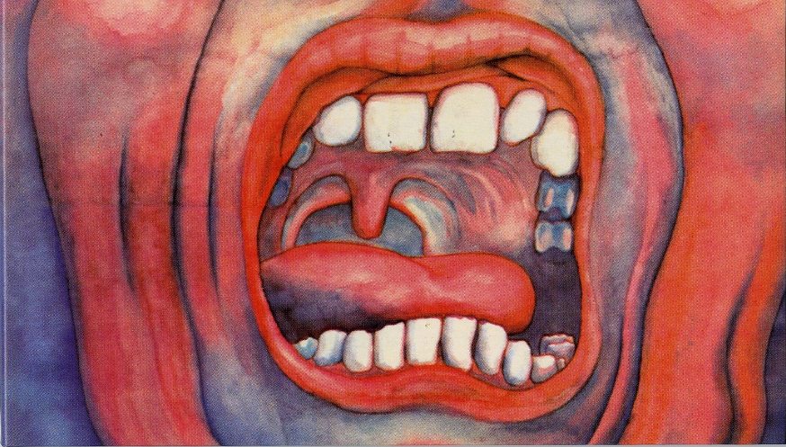
Speech to text and auto audio- transcription from video files
Ian Henderson
19 August 2020
Artwork: Barry Godber

Slide 3
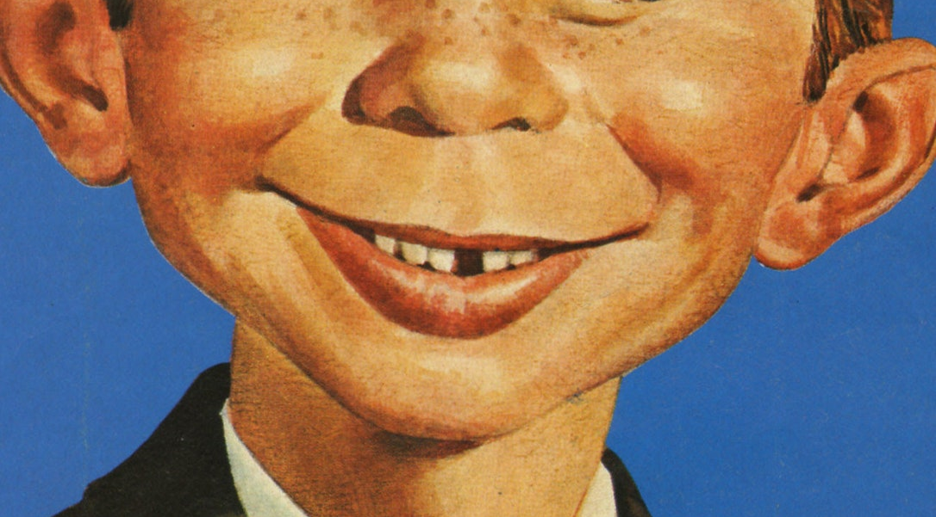
The interpretation of information delivered in speech
Humans interpret the information within a string of text or from speech by the following criteria:
Syntax: describes the formal structure of the language by aspects of grammar, such as:
word order (i.e. placement of verb, adjective, noun etc. relative to one another),
word-endings (variations to reflect tense, plural, declension)
Semantics: describes the meaning of words, and their linkages
Pragmatics: determines the context of words in use in relation to a given situation

Slide 4
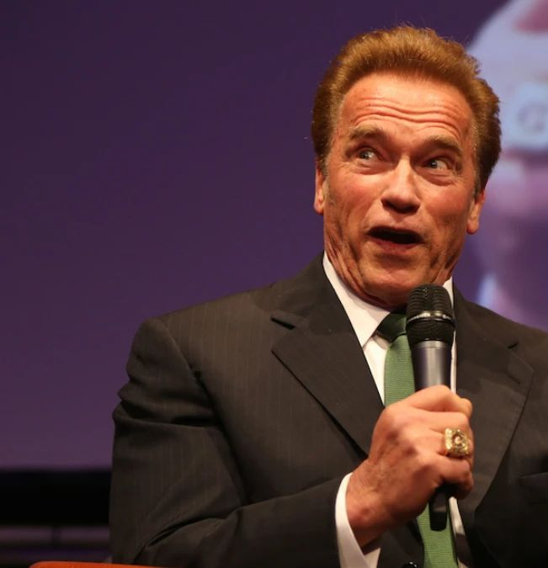
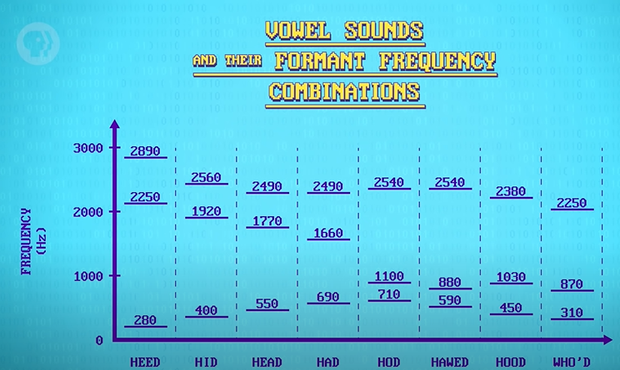
Natural Language Processing
As you talk and produce different sounds you produce amplified or reduced ‘resonances’ (vibrations of the vocal cords are reinforced by resonant vibrations in the oral and nasal passages). This are captured in a sound waveform.
In speech to text processing amplitude variations in an audio signal (from microphone in real time, or from a recording) are analysed to detect the magnitude in amplitude of the frequency components in the waveform that make up particular sounds within speech. Peaks in the frequency spectrum are called ‘formants’. All vowel sounds are composed of different combinations of formants.
A cyborg
Image Left: The conversion of waveform to frequencies is performed by a ‘Fast Fourier Transform’ algorithm.
Algorithm developments for processing natural language have allowed a move from reliance upon a set of rules to Machine Learning techniques, which can learn directly from existing datasets of language. The most accurate current speech recognitions systems at present are those that employ deep neural networks.
A microphone

Slide 5
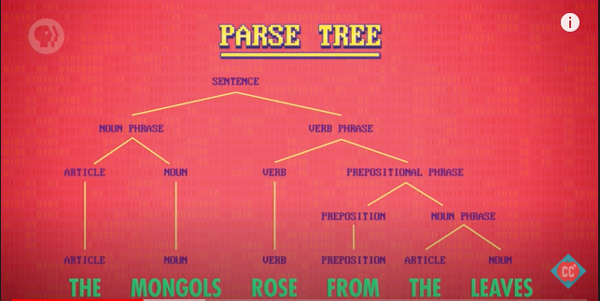
Parts of Speech recognition and phrase structure rules developed to encapsulate the grammar of language.
From established rules a ‘parse tree’ can be constructed. This can tag every word with a likely part of speech and help to establish how a sentence is constructed.
Elevation for clock dial for Big Ben tower

Slide 6
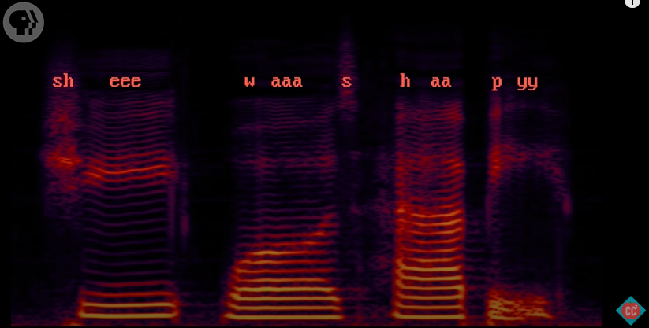
Image Right: A spectrogram visualisation of the spoken phrase: “She was happy”, which shows the variations in formant frequencies that produce the sound pieces known as ‘phonemes’ – the perceptually distinct units of sound in a specified language that distinguish one word from another). There are 44 in English. These can be recognised by computers for pattern matching.
“It’s the order, combination and context of these phonemes that allows the sophisticated audio analysis software to figure out what exactly you’re saying, like the bread, cheese and sauce that differentiate a pizza from a calzone or a sandwich.”
However…
https://scienceline.org/2014/08/ever-wondered-how-does-speech-to-text-software-work/#:~:text=When%20you%20speak%20the%20words,software%20can%20analyze%20your%20speech.

Slide 7

Language Modelling
As there are variations in personal speech patterns and accent, the accuracy of speech recognition can be greatly improved by use of a ‘language model’. Thereby, by probabilistic methods, a likely interpretation of individual words or a phrase can be made based on likely connections between words, both by grammatical structure and context.
Example: from an ambiguous speech source: ‘She was hungry’ is a more likely correct combination than: ‘She was Hungary.’
‘She was…’ is likely to be followed by an adjective, and the adjective hungry makes more sense than the proper noun: Hungary.
“For words that are pronounced the same way, such as eight and ate, the software analyzes the context and syntax of the sentence to figure out the best text match for the word you spoke.”
https://scienceline.org/2014/08/ever-wondered-how-does-speech-to-text-software-work/#:~:text=When%20you%20speak%20the%20words,software%20can%20analyze%20your%20speech.

Slide 8
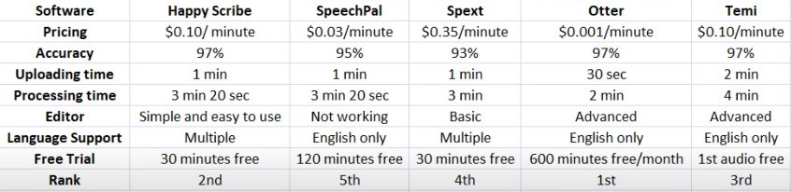
Speech to Text Services
Otter.ai
Vidnami
Express Scribe
VocalMatic
Speech.io
Sonix
Trint
YouTube
Dragon Dictate
Dragon Naturally Speaking
Google docs
SpokenData
Amazon Transcribe https://aws.amazon.com/transcribe/
SpeedScriber for Mac: https://www.youtube.com/watch?v=H7j2SlrSjBE
Captionsync https://www.automaticsync.com/captionsync/
https://www.youtube.com/watch?v=puPJ87nYc4M

Slide 9
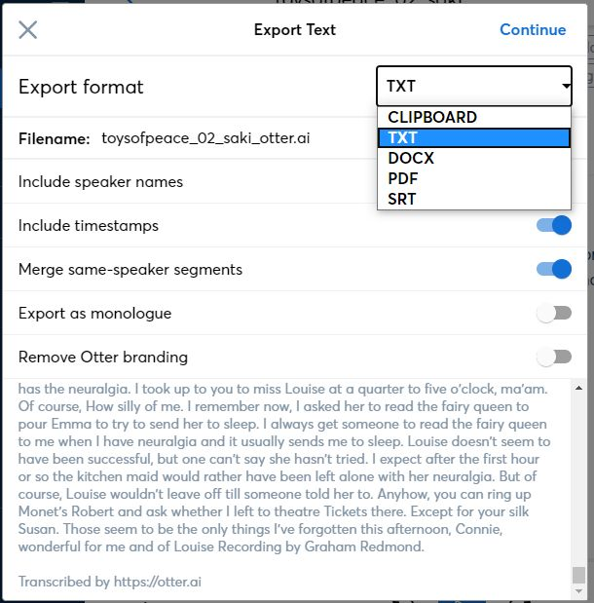
Otter.ai
Currently running a month’s trial at Premium. After that return to Free rate at: 600mins per month, longest duration file: 40mins. Premium Features (@ $8.33 per month):
import audio and video Otter lets you import existing recordings in the following formats:
audio: mp3, aac, wav, m4a, wma
video: mp4, avi, mov, wmv, mpg
advanced export additional formats: PDF, DOCX, SRT
Custom vocabulary
Synch audio and video from Dropbox
Bulk import and export
https://www.youtube.com/watch?v=puPJ87nYc4M

Slide 10
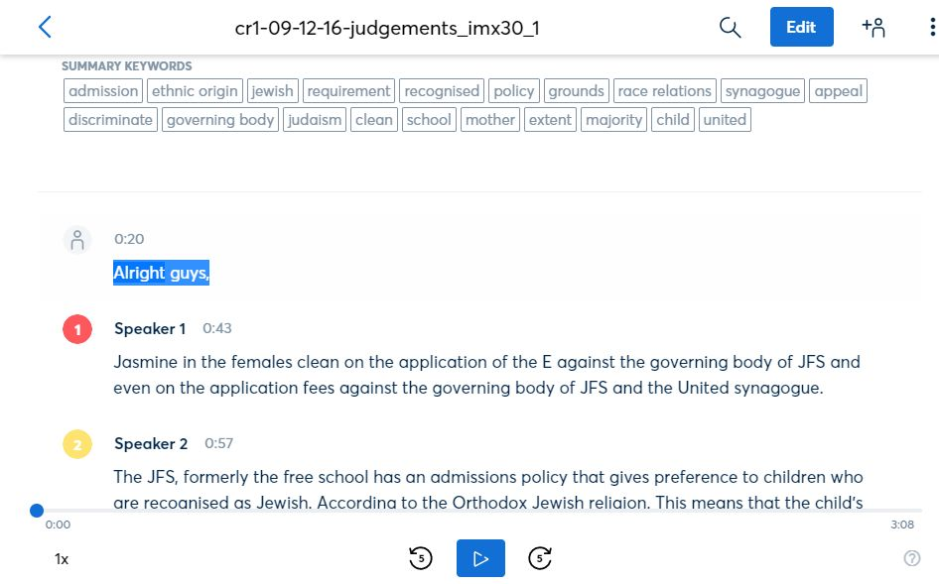
Otter.ai features
Edit within browser
Keywords
Timestamp
Word by word playback within app, - implies undelying timecode synch to word
https://ww.youtube.com/watch?v=puPJ87nYc4M
Speaker ID
Punctuation

Slide 11
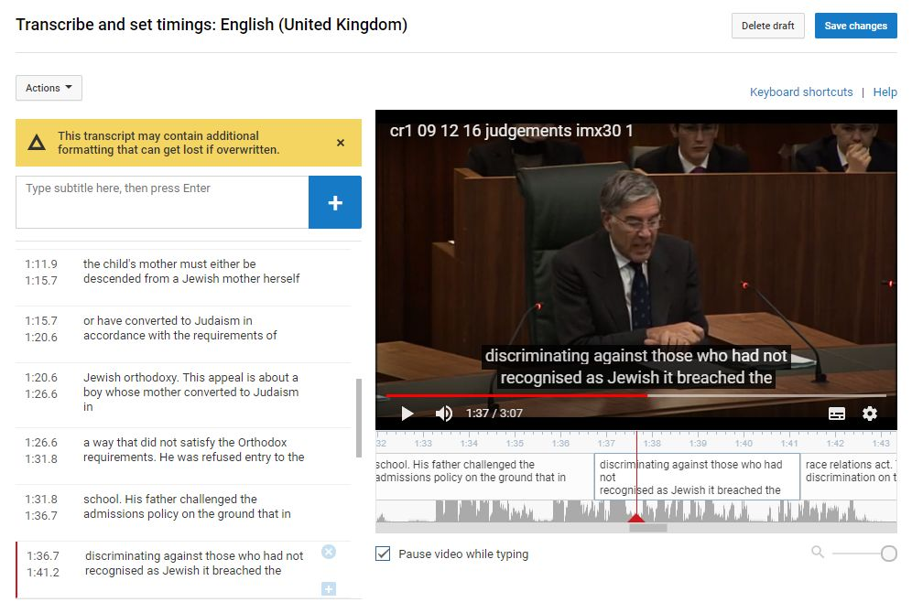
YouTube Studio features
Keywords
Edit within browser with video preview
Timestamps produced at more granular level
https://ww.youtube.com/watch?v=puPJ87nYc4M
NO Speaker ID?
NO punctuation?
Manual editing to synch text to speech on time line

Slide 12
YouTube Studio features
SHOW THE VIDEO: cr1 09 12 16 judgements imx30 SPEAKER2 BOOST.mp4

Slide 13
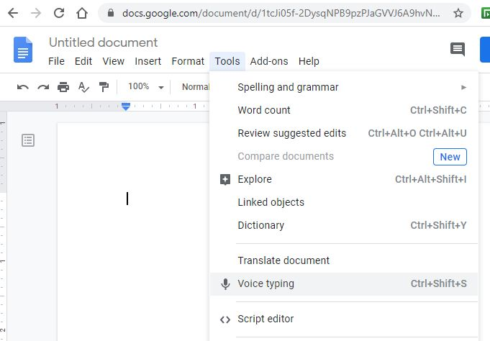
Google docs
Almost immediate -speech to text processing in real time. Google Docs can be used to automatically transcribe from ‘computer sound’ (for a source such as browser, or media-player) as well as via the PC microphone.
Edit within browser with video preview
NO timestamps
NO punctuation
NO Speaker ID
Manual editing and some useful export formats (for document output)

Slide 14
Google docs
SHOW THE VIDEO: UKSC_GoogleDocs_reduced_volume_test.mp4

Slide 15
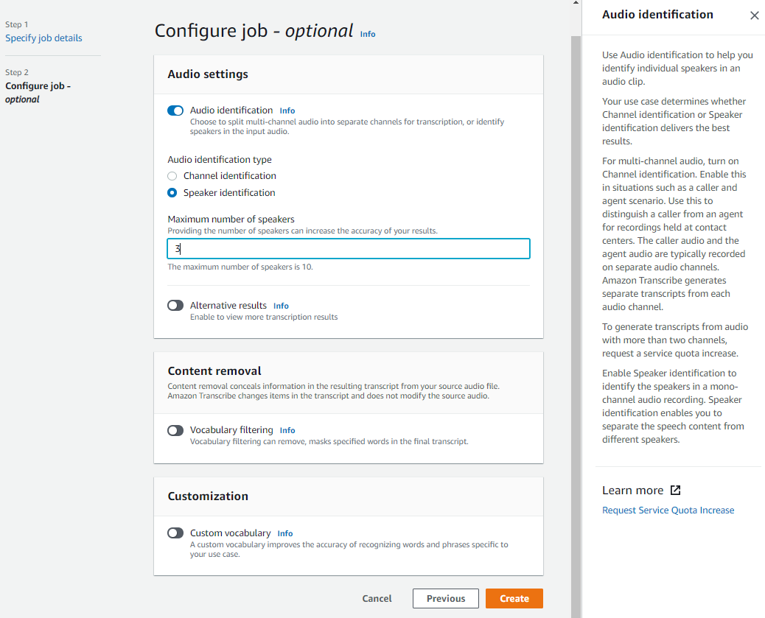
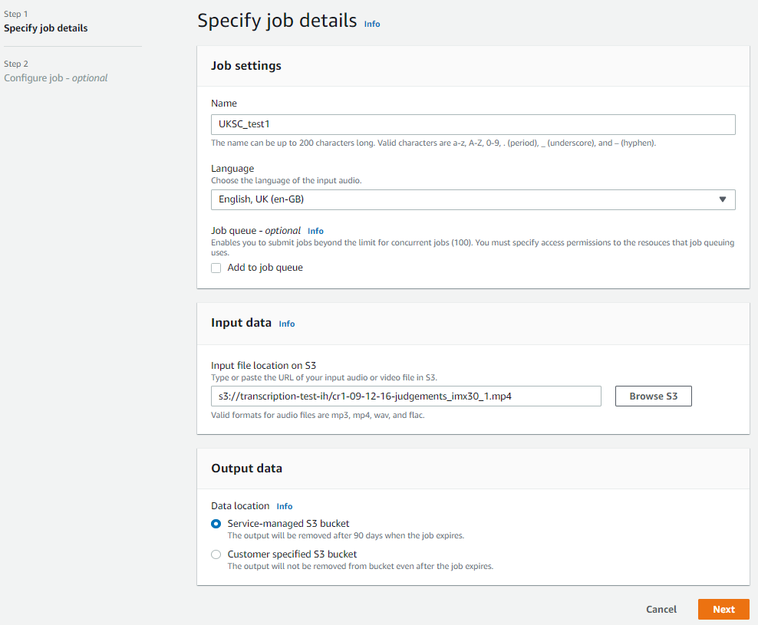
Amazon Transcribe
Upload of file to S3
Multiple lang and regional accent selection (EN-UK, US etc.)
Audio config options: speaker ID, multi-channel audio, ‘alternate results’ (multi-pass), voca filter and add custom vocab

Slide 16
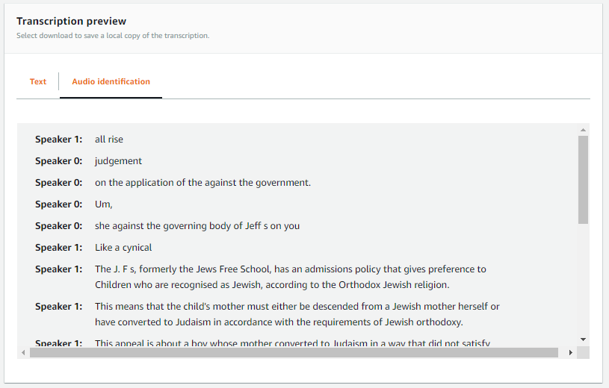
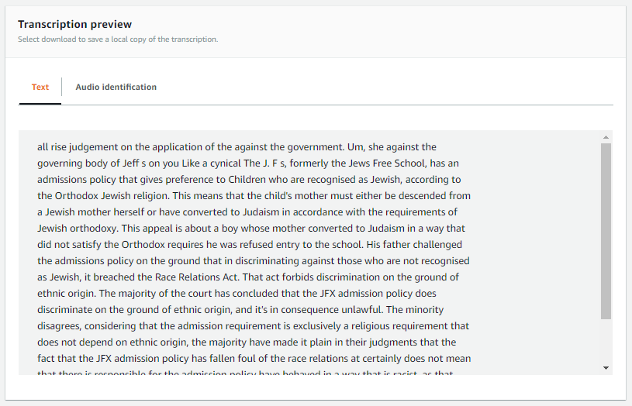
Amazon Transcribe
Speaker ID
Preview to screen

Slide 17
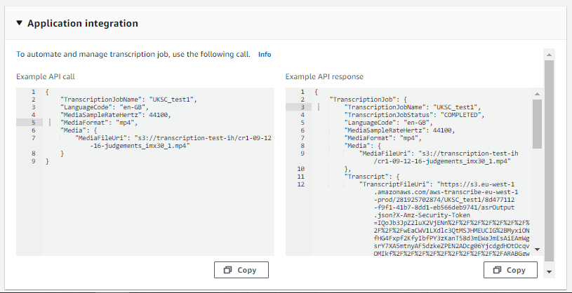
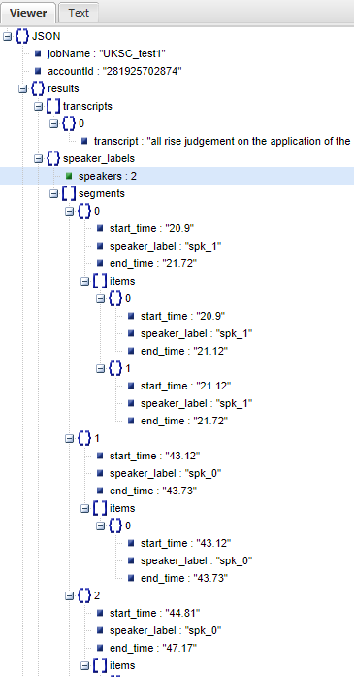
Amazon Transcribe
Application integration
Only output format: JSON
When ‘identify speakers’ feature is enabled then there are additional speaker segment and items elements ahead of the ‘word items’ within the JSON

Slide 18
Testing – consistency checks
GoogleDocs Three transcription runs were made against the same video (UKSC video: cr1-09-12-16-judgements_imx30_1.mp4 (from http://discovery.nationalarchives.gov.uk/VideoPlayer/?url=https://tna-video-player.s3.amazonaws.com/66/UKSC/1/cr1-09-12-16-judgements_imx30_1). The video was played from one Chrome browser instance, while GoogleDocs was used from a second.
As a visual estimate of consistency of capture, the text of each run was compared with another in the online tool ‘DiffChecker’ (https://www.diffchecker.com/diff). It can quickly be seen that there are particular points of inconsistency in capture, one is after the initial “All rise!” from a male usher, when a 2nd, female voice pronounces the initial case presentation (it should be noted that there is an extended pause in speech between the usher and the 2nd speaker). This section of speech is not very well recorded and when making a manual transcription I could not be certain as to all the words spoken. The initial few works spoken by a 3rd, male voice, which follows closely after the 2nd, are missed in all tests, - speculatively this may be due to a delay in the speech recognition engine becoming active from an ‘uncertainty’ in how to proceed. This 3rd voice is very clear and well recorded. Run 1 compared with Run 2: ‘11 removals, 10 additions’

Slide 19
Testing – consistency checks
SHOW THE TEST DOC: UKSC_cr1-09-12-16-judgements_imx30_1_Google_Docs_3-Run__CONSISTENCY Check.docx

Slide 20
Testing Example
PINK NOISE tests
Pink Noise (description here: https://www.audiocheck.net/) emulates magnetic tape noise.
Sample audio file obtained from https://www.arcaudio.com/node/245
4 files produced:
UKSC, with no pink noise with volume reduced down 1dB as the master level was peaking and beyond ‘0’ (results in digital clipping, then into distortion)
With Pink Noise sample at -30dB (of its original level). This would emulate noticeable tape hiss
With Pink Noise sample at -20dB (of its original level). This would emulate promient tape hiss
With Pink Noise sample at -15dB (of its original level). This would emulate extreme tape hiss
Tested on GoogleDocs

Slide 21
Pink Noise Test files
SHOW THE TEST VIDEOs: cr1-09-11-25-judgements_imx30_1_PURE_-1dB.mp4 cr1-09-11-25-judgements_imx30_1_PINK_at_-30dB.mp4 cr1-09-11-25-judgements_imx30_1_PINK_at_-15dB.mp4

Slide 22
Pink Noise Test results
SHOW THE DOC: Pink_Noise_Tests.docx

Slide 23
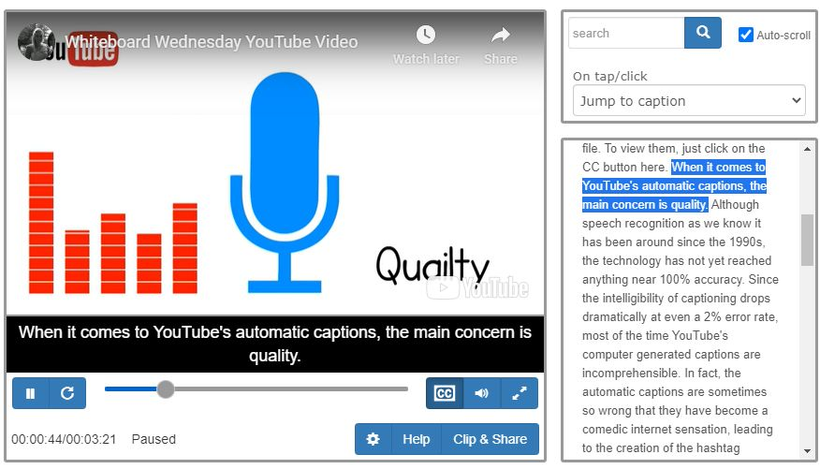
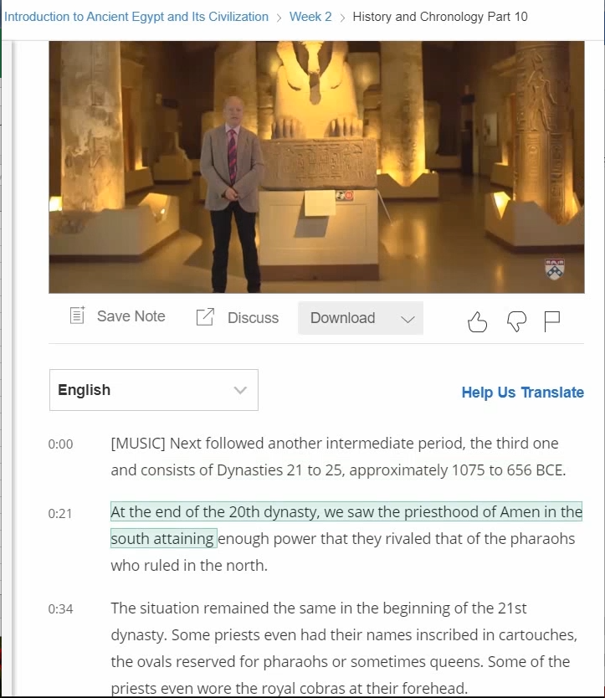
Transcription Presentation
Coursera model:
Language options?
Download options
Word by word highlighting, synch with speech. Works as Subtitles as well as idependant transcript

Slide 24
Transcription presentation
SHOW THE COURSERA CLIP:
Coursera_transcript_example.mp4

Slide 25
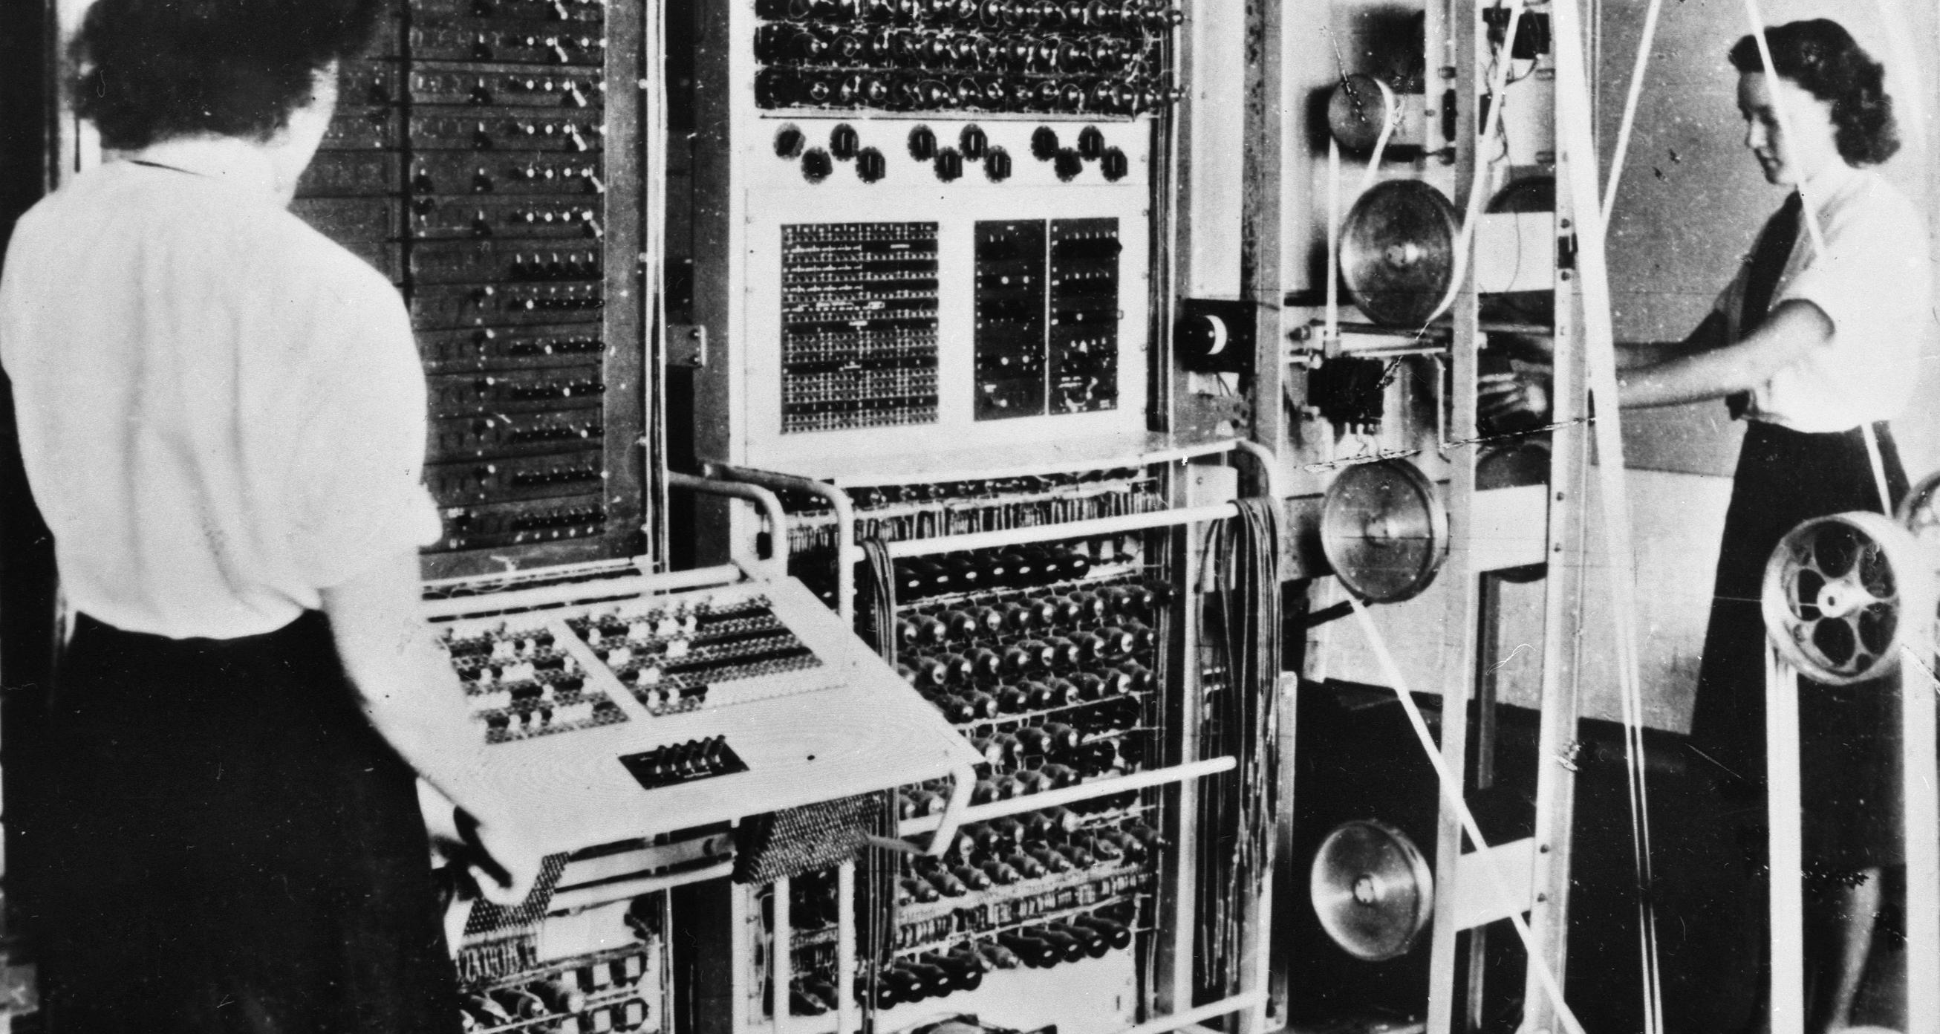
Colossus electronic digital computer

